Slide 1
Classification: Logistic Regression

Slide 2
Slide credits
Most of these slides were adapted from:
Hung-yi Lee (National Taiwan University)
Kris Kitani (Carnegie Mellon University).
Noah Snavely (Cornell University).
Fei-Fei Li (Stanford University).

Slide 3
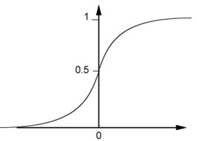

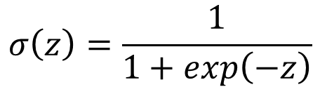

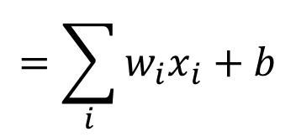


Step 1: Function Set
Function set:
Including all different w and b
$$P_{w,b}\left(C_{1}|x\right)≥0.5$$
class 1
z
0
$$P_{w,b}\left(C_{1}|x\right)<0.5$$
class 2
z
0
$$P_{w,b}\left(C_{1}|x\right)=σ\left(z\right)$$
$$=\sum_{i}{w_{i}x_{i}}+b$$
$$z=w∙x+b$$
$$σ\left(z\right)=\frac{1}{1+exp\left(−z\right)}$$

Slide 4

Step 1: Function Set
…
…
$$P_{w,b}\left(C_{1}|x\right)$$
…
…
Sigmoid Function

Slide 5










Step 2: Goodness of a Function
Training
Data
$$x^{1}$$
$$x^{2}$$
$$x^{3}$$
$$x^{N}$$
$$……$$
$$C_{1}$$
$$C_{1}$$
$$C_{2}$$
$$C_{1}$$
Assume the data is generated based on $f_{w,b}\left(x\right)=P_{w,b}\left(C_{1}|x\right)$
Given a set of w and b, what is its probability of generating the data?
$$L\left(w,b\right)=f_{w,b}\left(x^{1}\right)f_{w,b}\left(x^{2}\right)\left(1−f_{w,b}\left(x^{3}\right)\right)⋯f_{w,b}\left(x^{N}\right)$$
The most likely w* and b* is the one with the largest $L\left(w,b\right)$.
$$w^{∗},b^{∗}=arg\max_{w,b}{L\left(w,b\right)}$$

Slide 6




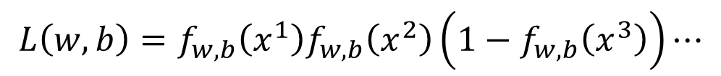










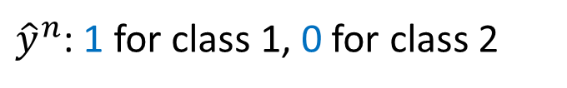

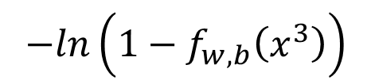


$$x^{1}$$
$$x^{2}$$
$$x^{3}$$
$$x^{1}$$
$$x^{2}$$
$$x^{3}$$
$$……$$
$$……$$
$$C_{1}$$
$$C_{1}$$
$$C_{2}$$
$${\hat{y}}^{1}=1$$
$${\hat{y}}^{2}=1$$
$${\hat{y}}^{3}=0$$
${\hat{y}}^{n}$: 1 for class 1, 0 for class 2
$$L\left(w,b\right)=f_{w,b}\left(x^{1}\right)f_{w,b}\left(x^{2}\right)\left(1−f_{w,b}\left(x^{3}\right)\right)⋯$$
$$w^{∗},b^{∗}=arg\max_{w,b}{L\left(w,b\right)}$$
=
$$w^{∗},b^{∗}=arg\min_{w,b}{−lnL\left(w,b\right)}$$
$$−lnL\left(w,b\right)$$
$$=−lnf_{w,b}\left(x^{1}\right)$$
1
$$−\left[{\hat{y}}^{1}lnf\left(x^{1}\right)+\left(1−{\hat{y}}^{1}\right)ln\left(1−f\left(x^{1}\right)\right)\right]$$
0
$$−lnf_{w,b}\left(x^{2}\right)$$
1
$$−\left[{\hat{y}}^{2}lnf\left(x^{2}\right)+\left(1−{\hat{y}}^{2}\right)ln\left(1−f\left(x^{2}\right)\right)\right]$$
0
$$−ln\left(1−f_{w,b}\left(x^{3}\right)\right)$$
$$−\left[{\hat{y}}^{3}lnf\left(x^{3}\right)+\left(1−{\hat{y}}^{3}\right)ln\left(1−f\left(x^{3}\right)\right)\right]$$
0
1
……

Slide 7


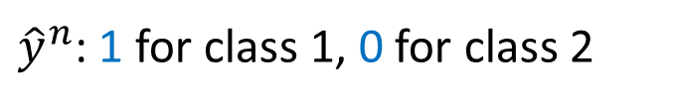
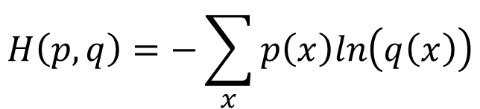
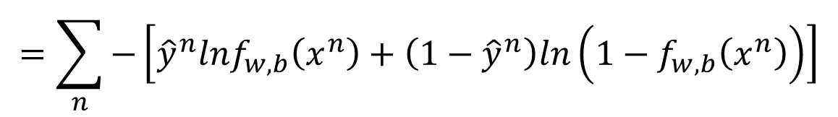


Step 2: Goodness of a Function
$$L\left(w,b\right)=f_{w,b}\left(x^{1}\right)f_{w,b}\left(x^{2}\right)\left(1−f_{w,b}\left(x^{3}\right)\right)⋯f_{w,b}\left(x^{N}\right)$$
$$−lnL\left(w,b\right)=lnf_{w,b}\left(x^{1}\right)+lnf_{w,b}\left(x^{2}\right)+ln\left(1−f_{w,b}\left(x^{3}\right)\right)⋯$$
${\hat{y}}^{n}$: 1 for class 1, 0 for class 2
$$=\sum_{n}{−\left[{\hat{y}}^{n}lnf_{w,b}\left(x^{n}\right)+\left(1−{\hat{y}}^{n}\right)ln\left(1−f_{w,b}\left(x^{n}\right)\right)\right]}$$
Cross entropy between two Bernoulli distribution
Distribution p:
Distribution q:
$$p\left(x=1\right)={\hat{y}}^{n}$$
cross entropy
$$q\left(x=1\right)=f\left(x^{n}\right)$$
$$p\left(x=0\right)={1−\hat{y}}^{n}$$
$$q\left(x=0\right)=1−f\left(x^{n}\right)$$
$$H\left(p,q\right)=−\sum_{x}{p\left(x\right)ln\left(q\left(x\right)\right)}$$

Slide 8



Step 2: Goodness of a Function
$$L\left(w,b\right)=f_{w,b}\left(x^{1}\right)f_{w,b}\left(x^{2}\right)\left(1−f_{w,b}\left(x^{3}\right)\right)⋯f_{w,b}\left(x^{N}\right)$$
$$−lnL\left(w,b\right)=lnf_{w,b}\left(x^{1}\right)+lnf_{w,b}\left(x^{2}\right)+ln\left(1−f_{w,b}\left(x^{3}\right)\right)⋯$$
${\hat{y}}^{n}$: 1 for class 1, 0 for class 2
$$=\sum_{n}{−\left[{\hat{y}}^{n}lnf_{w,b}\left(x^{n}\right)+\left(1−{\hat{y}}^{n}\right)ln\left(1−f_{w,b}\left(x^{n}\right)\right)\right]}$$
Cross entropy between two Bernoulli distribution
minimize
1.0
$$f\left(x^{n}\right)$$
0.0
cross entropy
$$1−f\left(x^{n}\right)$$
Ground Truth
$${\hat{y}}^{n}=1$$

Slide 9
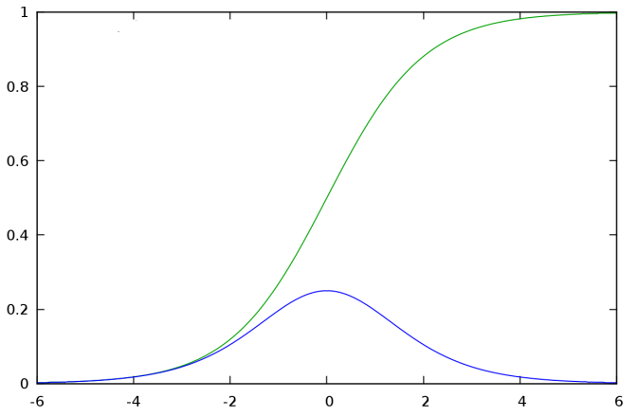

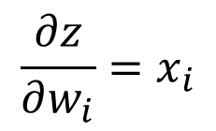


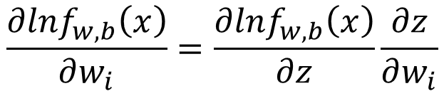

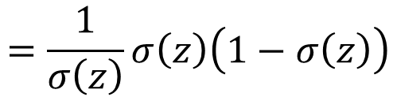


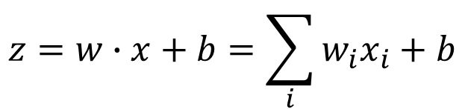
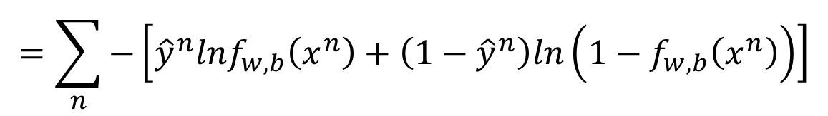
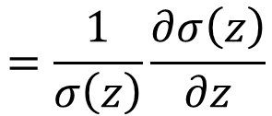
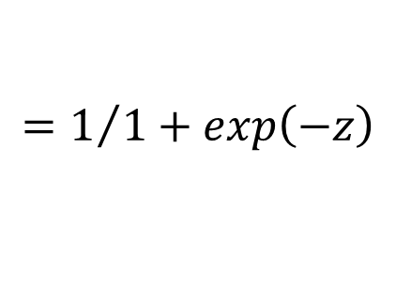



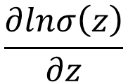
Step 3: Find the best function
$$\left(1−f_{w,b}\left(x^{n}\right)\right)x_{i}^{n}$$
$$=\sum_{n}{−\left[{\hat{y}}^{n}lnf_{w,b}\left(x^{n}\right)+\left(1−{\hat{y}}^{n}\right)ln\left(1−f_{w,b}\left(x^{n}\right)\right)\right]}$$
$$−lnL\left(w,b\right)$$
$$∂w_{i}$$
$$∂w_{i}$$
$$∂w_{i}$$
$$\frac{∂lnf_{w,b}\left(x\right)}{∂w_{i}}=\frac{∂lnf_{w,b}\left(x\right)}{∂z}\frac{∂z}{∂w_{i}}$$
$$\frac{∂z}{∂w_{i}}=x_{i}$$
$$σ\left(z\right)$$
$$\frac{∂σ\left(z\right)}{∂z}$$
$$\frac{∂lnσ\left(z\right)}{∂z}$$
$$=\frac{1}{σ\left(z\right)}\frac{∂σ\left(z\right)}{∂z}$$
$$=\frac{1}{σ\left(z\right)}σ\left(z\right)\left(1−σ\left(z\right)\right)$$
$$f_{w,b}\left(x\right)$$
$$=σ\left(z\right)$$
$$z=w∙x+b=\sum_{i}{w_{i}x_{i}}+b$$
$$=1/{1+exp\left(−z\right)}$$

Slide 10

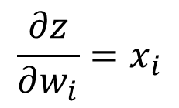
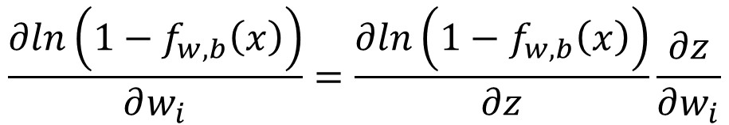

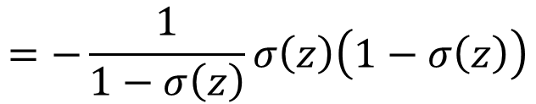
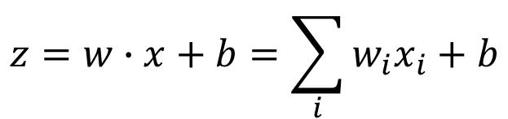
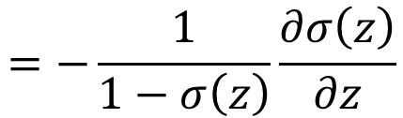
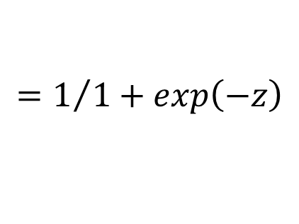

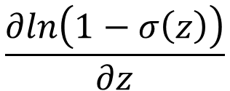
Step 3: Find the best function
$$\left(1−f_{w,b}\left(x^{n}\right)\right)x_{i}^{n}$$
$$−f_{w,b}\left(x^{n}\right)x_{i}^{n}$$
$$=\sum_{n}{−\left[{\hat{y}}^{n}lnf_{w,b}\left(x^{n}\right)+\left(1−{\hat{y}}^{n}\right)ln\left(1−f_{w,b}\left(x^{n}\right)\right)\right]}$$
$$−lnL\left(w,b\right)$$
$$∂w_{i}$$
$$∂w_{i}$$
$$∂w_{i}$$
$$\frac{∂ln\left(1−f_{w,b}\left(x\right)\right)}{∂w_{i}}=\frac{∂ln\left(1−f_{w,b}\left(x\right)\right)}{∂z}\frac{∂z}{∂w_{i}}$$
$$\frac{∂z}{∂w_{i}}=x_{i}$$
$$\frac{∂ln\left(1−σ\left(z\right)\right)}{∂z}$$
$$=−\frac{1}{1−σ\left(z\right)}\frac{∂σ\left(z\right)}{∂z}$$
$$=−\frac{1}{1−σ\left(z\right)}σ\left(z\right)\left(1−σ\left(z\right)\right)$$
$$f_{w,b}\left(x\right)$$
$$=σ\left(z\right)$$
$$z=w∙x+b=\sum_{i}{w_{i}x_{i}}+b$$
$$=1/{1+exp\left(−z\right)}$$

Slide 11
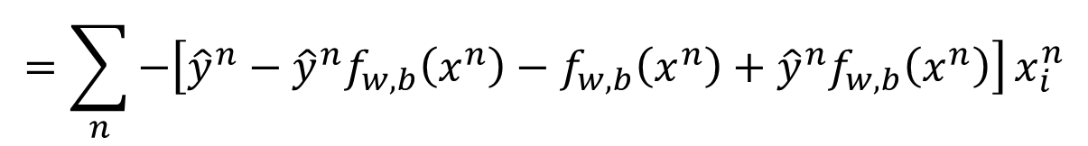
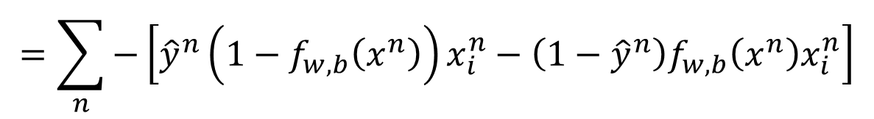

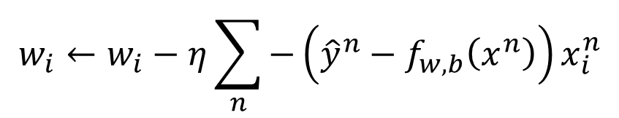
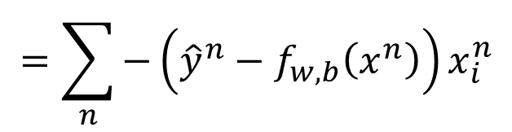
Step 3: Find the best function
$$\left(1−f_{w,b}\left(x^{n}\right)\right)x_{i}^{n}$$
$$−f_{w,b}\left(x^{n}\right)x_{i}^{n}$$
$$=\sum_{n}{−\left[{\hat{y}}^{n}lnf_{w,b}\left(x^{n}\right)+\left(1−{\hat{y}}^{n}\right)ln\left(1−f_{w,b}\left(x^{n}\right)\right)\right]}$$
$$−lnL\left(w,b\right)$$
$$∂w_{i}$$
$$∂w_{i}$$
$$∂w_{i}$$
$$=\sum_{n}{−\left[{\hat{y}}^{n}\left(1−f_{w,b}\left(x^{n}\right)\right)x_{i}^{n}−\left(1−{\hat{y}}^{n}\right)f_{w,b}\left(x^{n}\right)x_{i}^{n}\right]}$$
$$=\sum_{n}{−\left[{\hat{y}}^{n}−{\hat{y}}^{n}f_{w,b}\left(x^{n}\right)−f_{w,b}\left(x^{n}\right)+{\hat{y}}^{n}f_{w,b}\left(x^{n}\right)\right]}x_{i}^{n}$$
$$=\sum_{n}{−\left({\hat{y}}^{n}−f_{w,b}\left(x^{n}\right)\right)x_{i}^{n}}$$
Larger difference, larger update
$$w_{i}←w_{i}−η\sum_{n}{−\left({\hat{y}}^{n}−f_{w,b}\left(x^{n}\right)\right)x_{i}^{n}}$$

Slide 12

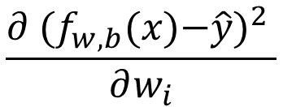

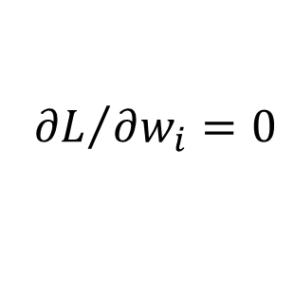
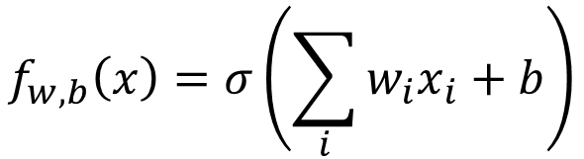
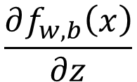
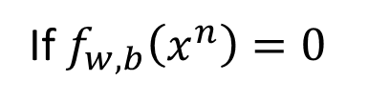

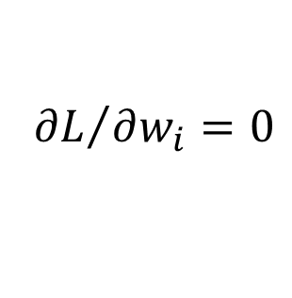
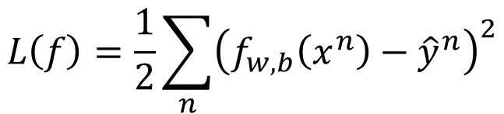
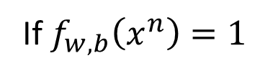

Logistic Regression + Square Error
$$f_{w,b}\left(x\right)=σ\left(\sum_{i}{w_{i}x_{i}}+b\right)$$
Step 1:
Step 2:
Training data: $\left(x^{n},{\hat{y}}^{n}\right)$, ${\hat{y}}^{n}$: 1 for class 1, 0 for class 2
$$L\left(f\right)=\frac{1}{2}\sum_{n}{{\left(f_{w,b}\left(x^{n}\right)−{\hat{y}}^{n}\right)}^{2}}$$
Step 3:
$$\frac{∂f_{w,b}\left(x\right)}{∂z}$$
$$\frac{∂z}{∂w_{i}}$$
$$=2\left(f_{w,b}\left(x\right)−\hat{y}\right)$$
$$\frac{∂ {(f_{w,b}\text{(}\text{x}\text{)−}\hat{y})}^{2} }{∂w_{i}}$$
$$=2\left(f_{w,b}\left(x\right)−\hat{y}\right)f_{w,b}\left(x\right)\left(1−f_{w,b}\left(x\right)\right)x_{i}$$
$${\hat{y}}^{n}=1$$
If $f_{w,b}\left(x^{n}\right)=1$
(close to target)
$${∂L}/{∂w_{i}}=0$$
If $f_{w,b}\left(x^{n}\right)=0$
(far from target)
$${∂L}/{∂w_{i}}=0$$

Slide 13

Logistic Regression + Square Error
$$f_{w,b}\left(x\right)=σ\left(\sum_{i}{w_{i}x_{i}}+b\right)$$
Step 1:
Step 2:
Training data: $\left(x^{n},{\hat{y}}^{n}\right)$, ${\hat{y}}^{n}$: 1 for class 1, 0 for class 2
$$L\left(f\right)=\frac{1}{2}\sum_{n}{{\left(f_{w,b}\left(x^{n}\right)−{\hat{y}}^{n}\right)}^{2}}$$
Step 3:
$$\frac{∂f_{w,b}\left(x\right)}{∂z}$$
$$\frac{∂z}{∂w_{i}}$$
$$=2\left(f_{w,b}\left(x\right)−\hat{y}\right)$$
$$\frac{∂ {(f_{w,b}\text{(}\text{x}\text{)−}\hat{y})}^{2} }{∂w_{i}}$$
$$=2\left(f_{w,b}\left(x\right)−\hat{y}\right)f_{w,b}\left(x\right)\left(1−f_{w,b}\left(x\right)\right)x_{i}$$
$${\hat{y}}^{n}=0$$
If $f_{w,b}\left(x^{n}\right)=1$
(far from target)
$${∂L}/{∂w_{i}}=0$$
If $f_{w,b}\left(x^{n}\right)=0$
(close to target)
$${∂L}/{∂w_{i}}=0$$

Slide 14
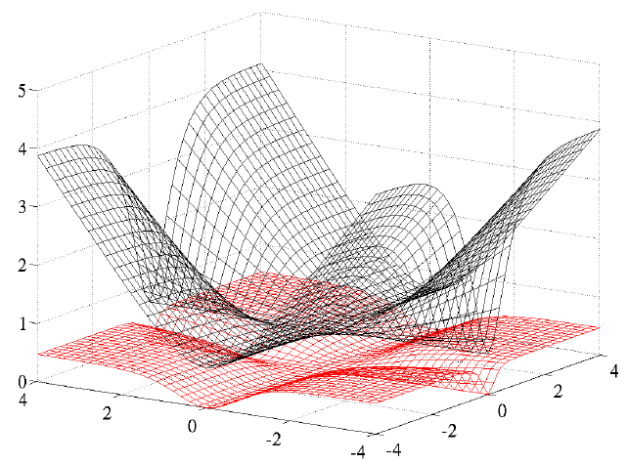
Cross Entropy v.s. Square Error
Cross Entropy
Total
Loss
Square
Error
w₁
w₂
http://jmlr.org/proceedings/papers/v9/glorot10a/glorot10a.pdf

Slide 15
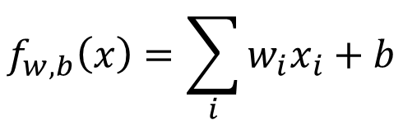
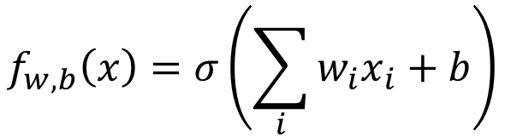
Logistic Regression
Linear Regression
$$f_{w,b}\left(x\right)=σ\left(\sum_{i}{w_{i}x_{i}}+b\right)$$
$$f_{w,b}\left(x\right)=\sum_{i}{w_{i}x_{i}}+b$$
Step 1:
Output: between 0 and 1
Output: any value
Step 2:
Step 3:

Slide 16
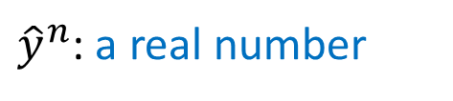
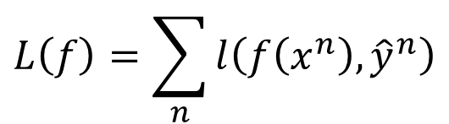
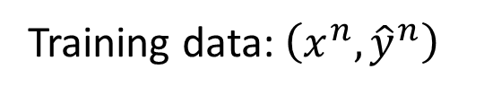
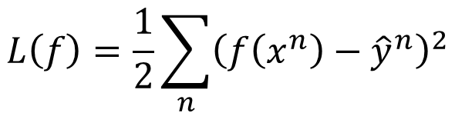
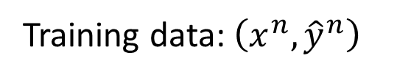

Logistic Regression
Linear Regression
$$f_{w,b}\left(x\right)=σ\left(\sum_{i}{w_{i}x_{i}}+b\right)$$
$$f_{w,b}\left(x\right)=\sum_{i}{w_{i}x_{i}}+b$$
Step 1:
Output: between 0 and 1
Output: any value
Training data: $\left(x^{n},{\hat{y}}^{n}\right)$
Training data: $\left(x^{n},{\hat{y}}^{n}\right)$
Step 2:
${\hat{y}}^{n}$: 1 for class 1, 0 for class 2
${\hat{y}}^{n}$: a real number
$$L\left(f\right)=\sum_{n}{l\left(f\left(x^{n}\right),{\hat{y}}^{n}\right)}$$
$$L\left(f\right)=\frac{1}{2}\sum_{n}{{\left(f\left(x^{n}\right)−{\hat{y}}^{n}\right)}^{2}}$$
Cross entropy:
$$l\left(f\left(x^{n}\right),{\hat{y}}^{n}\right)=−\left[{\hat{y}}^{n}lnf\left(x^{n}\right)+\left(1−{\hat{y}}^{n}\right)ln\left(1−f\left(x^{n}\right)\right)\right]$$

Slide 17
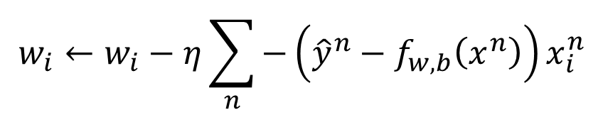
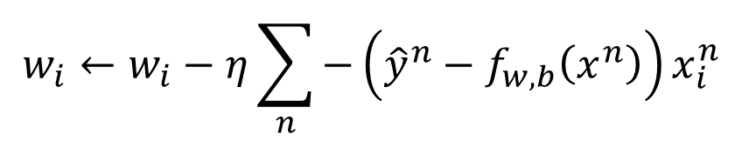
Logistic Regression
Linear Regression
$$f_{w,b}\left(x\right)=σ\left(\sum_{i}{w_{i}x_{i}}+b\right)$$
$$f_{w,b}\left(x\right)=\sum_{i}{w_{i}x_{i}}+b$$
Step 1:
Output: between 0 and 1
Output: any value
Training data: $\left(x^{n},{\hat{y}}^{n}\right)$
Training data: $\left(x^{n},{\hat{y}}^{n}\right)$
Step 2:
${\hat{y}}^{n}$: 1 for class 1, 0 for class 2
${\hat{y}}^{n}$: a real number
$$L\left(f\right)=\sum_{n}{l\left(f\left(x^{n}\right),{\hat{y}}^{n}\right)}$$
$$L\left(f\right)=\frac{1}{2}\sum_{n}{{\left(f\left(x^{n}\right)−{\hat{y}}^{n}\right)}^{2}}$$
$$w_{i}←w_{i}−η\sum_{n}{−\left({\hat{y}}^{n}−f_{w,b}\left(x^{n}\right)\right)x_{i}^{n}}$$
Logistic regression:
Step 3:
$$w_{i}←w_{i}−η\sum_{n}{−\left({\hat{y}}^{n}−f_{w,b}\left(x^{n}\right)\right)x_{i}^{n}}$$
Linear regression:

Slide 18


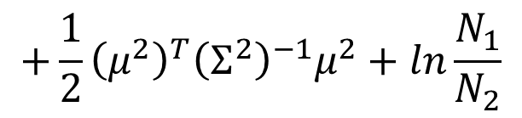
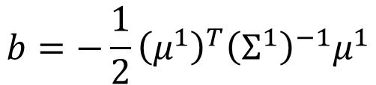

Discriminative v.s. Generative
$$P\left(C_{1}|x\right)=σ\left(w∙x+b\right)$$
directly find w and b
Find $μ^{1}$, $μ^{2}$, $Σ^{−1}$
$$w^{T}={\left(μ^{1}−μ^{2}\right)}^{T}Σ^{−1}$$
$$b=−\frac{1}{2}{\left(μ^{1}\right)}^{T}{\left(Σ^{1}\right)}^{−1}μ^{1}$$
Will we obtain the same set of w and b?
$$+\frac{1}{2}{\left(μ^{2}\right)}^{T}{\left(Σ^{2}\right)}^{−1}μ^{2}+ln\frac{N_{1}}{N_{2}}$$
The same model (function set), but different function may be selected by the same training data.

Slide 19


Generative v.s. Discriminative
Generative
Discriminative
All: hp, att, sp att, de, sp de, speed
73% accuracy
79% accuracy

Slide 20

Generative v.s. Discriminative
Example
Training
Data
1
1
0
0
X 4
X 4
X 4
1
0
1
0
Class 1
Class 2
Class 2
Class 2
Testing
Data
1
How about Naïve Bayes?
Class 1?
Class 2?
1
$$P\left(x|C_{i}\right)=P\left(x_{1}|C_{i}\right)P\left(x_{2}|C_{i}\right)$$

Slide 21






Generative v.s. Discriminative
Example
Training
Data
1
1
0
0
X 4
X 4
X 4
1
0
1
0
Class 1
Class 2
Class 2
Class 2
$$P\left(C_{1}\right)=\frac{1}{13}$$
$$P\left(x_{1}=1|C_{1}\right)=1$$
$$P\left(x_{2}=1|C_{1}\right)=1$$
$$P\left(C_{2}\right)=\frac{12}{13}$$
$$P\left(x_{1}=1|C_{2}\right)=\frac{1}{3}$$
$$P\left(x_{2}=1|C_{2}\right)=\frac{1}{3}$$

Slide 22








Training
Data
1
1
0
0
X 4
X 4
X 4
1
0
1
0
Class 1
Class 2
Class 2
Class 2
$$\frac{1}{13}$$
$$1×1$$
<0.5
$$=\frac{P\left(x|C_{1}\right)P\left(C_{1}\right)}{P\left(x|C_{1}\right)P\left(C_{1}\right)+P\left(x|C_{2}\right)P\left(C_{2}\right)}$$
Testing
Data
1
$$P\left(C_{1}|x\right)$$
1
$$\frac{1}{13}$$
$$\frac{1}{3}×\frac{1}{3}$$
$$\frac{12}{13}$$
$$1×1$$
$$P\left(C_{1}\right)=\frac{1}{13}$$
$$P\left(x_{1}=1|C_{1}\right)=1$$
$$P\left(x_{2}=1|C_{1}\right)=1$$
$$P\left(C_{2}\right)=\frac{12}{13}$$
$$P\left(x_{1}=1|C_{2}\right)=\frac{1}{3}$$
$$P\left(x_{2}=1|C_{2}\right)=\frac{1}{3}$$

Slide 23
Generative v.s. Discriminative
Usually people believe discriminative model is better
Benefit of generative model
With the assumption of probability distribution
less training data is needed
more robust to the noise
Priors and class-dependent probabilities can be estimated from different sources.

Slide 24







Multi-class Classification
(3 classes as example)
C₁:
$$z_{1}=w^{1}∙x+b_{1}$$
Probability:
$1>y_{i}>0$
$\sum_{i}{y_{i}=1}$
$$w^{1},b_{1}$$
C₂:
$$w^{2},b_{2}$$
$$z_{2}=w^{2}∙x+b_{2}$$
C₃:
$$w^{3},b_{3}$$
$$z_{3}=w^{3}∙x+b_{3}$$
Softmax
3
20
0.88
1
2.7
0.12
-3
0.05
≈0

Slide 25

















Multi-class Classification
[Bishop, P209-210]
(3 classes as example)
$$z_{1}=w^{1}∙x+b_{1}$$
Cross Entropy
$$x$$
$$z_{2}=w^{2}\text{∙}x+b_{2}$$
Softmax
$$−\sum_{i=1}^{3}{{\hat{y}}_{i}lny_{i}}$$
$$z_{3}=w^{3}\text{∙}x+b_{3}$$
target
If x $∈$ class 1
If x $∈$ class 2
If x $∈$ class 3
$$\left[\begin{aligned}1 \\ 0 \\ 0\end{aligned}\right]$$
$$\left[\begin{aligned}0 \\ 1 \\ 0\end{aligned}\right]$$
$$\left[\begin{aligned}0 \\ 0 \\ 1\end{aligned}\right]$$
$$\hat{y}=$$
$$\hat{y}=$$
$$\hat{y}=$$
$$−lny_{1}$$
$$−lny_{2}$$
$$−lny_{3}$$

Slide 26



Limitation of Logistic Regression
$$(z≥0)$$
$$(z<0)$$
Can we?
Input Feature |  | Label
x₁ | x₂
0 | 0 | Class 2
0 | 1 | Class 1
1 | 0 | Class 1
1 | 1 | Class 2
z ≥ 0
z < 0
z < 0
z ≥ 0

Slide 27












Limitation of Logistic Regression
$x_{1}^{′}$: distance to $\left[\begin{aligned}0 \\ 0\end{aligned}\right]$
$x_{2}^{′}$: distance to $\left[\begin{aligned}1 \\ 1\end{aligned}\right]$
Feature transformation
$$\left[\begin{aligned}x_{1} \\ x_{2}\end{aligned}\right]$$
$$\left[\begin{aligned}x_{1}^{′} \\ x_{2}^{′}\end{aligned}\right]$$
Not always easy ….. domain knowledge can be helpful
$$x_{2}^{′}$$
$$\left[\begin{aligned}0 \\ \sqrt{2}\end{aligned}\right]$$
$$\left[\begin{aligned}0 \\ 1\end{aligned}\right]$$
$$\left[\begin{aligned}1 \\ 1\end{aligned}\right]$$
$$\left[\begin{aligned}0 \\ 0\end{aligned}\right]$$
$$\left[\begin{aligned}1 \\ 0\end{aligned}\right]$$
$$\left[\begin{aligned}1 \\ 1\end{aligned}\right]$$
$$\left[\begin{aligned}\sqrt{2} \\ 0\end{aligned}\right]$$
$$x_{1}^{′}$$

Slide 28


Limitation of Logistic Regression
Cascading logistic regression models
$$x_{1}^{′}$$
$$x_{2}^{′}$$
Feature Transformation
Classification
(ignore bias in this figure)

Slide 29


Deep Learning!
All the parameters of the logistic regressions are jointly learned.
“Neuron”
$$x_{1}^{′}$$
$$x_{2}^{′}$$
Feature Transformation
Classification
Neural Network

Slide 30
Reference
Bishop: Chapter 4.3

Slide 31
Appendix

Slide 32

















Three Steps
$$x^{1}$$
$$x^{2}$$
$$x^{3}$$
$$x^{n}$$
$$……$$
$${\hat{y}}^{1}$$
$${\hat{y}}^{2}$$
$${\hat{y}}^{3}$$
$${\hat{y}}^{n}$$
$${\hat{y}}^{n}=class 1,class 2$$
Step 1. Function Set (Model)
Step 2. Goodness of a function
Step 3. Find the best function: gradient descent
$$x$$
If $P\left(C_{1}|x\right)>0.5$, output: y = class 1
$$y$$
feature
Otherwise, output: y = class 2
class
$$P\left(C_{1}|x\right)=σ\left(w∙x+b\right)$$
w and b are related to$N_{1},$ $N_{2}$, $μ^{1}$, $μ^{2}$, $Σ$
$$L\left(f\right)=\sum_{n}{δ\left(f\left(x^{n}\right)≠{\hat{y}}^{n}\right)}$$
$$L\left(f\right)=\sum_{n}{l\left(f\left(x^{n}\right)≠{\hat{y}}^{n}\right)}$$

Slide 33









Step 2: Loss function
z
$$≥$$
0
class 1
+1
$$f_{w,b}\left(x\right)=$$
z
$$<$$
0
class 2
-1
Ideal loss:
Approximation:
$$L\left(f\right)=\sum_{n}{δ\left(f\left(x^{n}\right)≠{\hat{y}}^{n}\right)}$$
$$L\left(f\right)=\sum_{n}{l\left(f\left(x^{n}\right),{\hat{y}}^{n}\right)}$$
0 or 1
$l\left(∗\right)$ is the upper bound of $δ\left(∗\right)$
Ideal loss
$$δ\left(f\left(x^{n}\right)≠{\hat{y}}^{n}\right)$$
$${\hat{y}}^{n}z^{n}$$

Slide 34


















Step 2: Loss function
$l\left(f\left(x^{n}\right),{\hat{y}}^{n}\right)$: cross entropy
$${\hat{y}}^{n}=+1$$
$$f\left(x^{n}\right)$$
Ground
Truth
cross entropy
1.0
$${\hat{y}}^{n}=−1$$
$$1−f\left(x^{n}\right)$$
If ${\hat{y}}^{n}=+1$:
$$=−ln\frac{1}{1+exp\left(−z^{n}\right)}$$
$$l\left(f\left(x^{n}\right),{\hat{y}}^{n}\right)=−lnf\left(x^{n}\right)$$
$$=−lnσ\left(z^{n}\right)$$
$$=ln\left(1+exp\left(−z^{n}\right)\right)$$
$$=ln\left(1+exp\left(−{{\hat{y}}^{n}z}^{n}\right)\right)$$
If ${\hat{y}}^{n}=−1$:
$$l\left(f\left(x^{n}\right),{\hat{y}}^{n}\right)=−ln\left(1−f\left(x^{n}\right)\right)$$
$$=−ln\frac{exp\left(−z^{n}\right)}{1+exp\left(−z^{n}\right)}$$
$$=−ln\frac{1}{1+exp\left(z^{n}\right)}$$
$$=−ln\left(1−σ\left(x^{n}\right)\right)$$
$$=ln\left(1+exp\left(z^{n}\right)\right)$$
$$=ln\left(1+exp\left(−{{\hat{y}}^{n}z}^{n}\right)\right)$$

Slide 35





Step 2: Loss function
$l\left(f\left(x^{n}\right),{\hat{y}}^{n}\right)$: cross entropy
$$l\left(f\left(x^{n}\right),{\hat{y}}^{n}\right)=ln\left(1+exp\left(−{{\hat{y}}^{n}z}^{n}\right)\right)$$
Ideal loss
$$δ\left(f\left(x^{n}\right)≠{\hat{y}}^{n}\right)$$
Divided by ln2 here
$${\hat{y}}^{n}z^{n}$$

